Slide 1
Balance Sheet

Slide 2
Balance Sheet
It is prepared as on the last day of the accounting period. It also has assets and liabilities and prepared based on accounting equation. But, there’s no capital account. Instead there is a capital fund. The surplus or deficit from Income & Expenditure Account is adjusted against this capital fund at the end of the year.

Slide 3
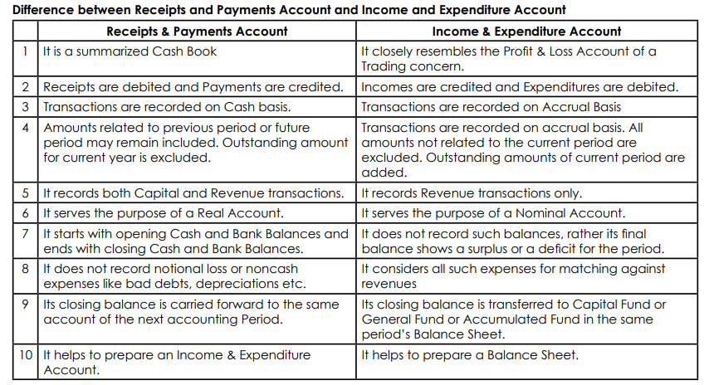

Slide 4
